Slide 1

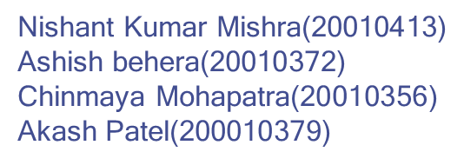
ACUTE LYMPHOBLASTIC LEUKEMIA DETECTION USING DEEP LEARNING
Guided By - Prof. Manas Ranjan Mishra

Slide 2
OUTLINES
1.
4.
2.
3.
Literature Survey
Problem Specification
Proposed Solution with block diagram
Abstract
5.
Results and Discussion
Introduction
6.

Slide 3
Problem Specification
The development of an efficient deep learning based model for the early detection of Acute Lymphoblastic Leukemia (ALL) which can significantly impact patient care by enabling quicker and more precise diagnosis.
It can assist healthcare professionals in making informed decisions and ultimately improve the prognosis and survival rates of Acute Lymphoblastic Leukemia (ALL) patients. However, it is essential to approach this problem with the utmost care, adhering to medical ethics and regulations, and continuously validating and improving the model's performance in clinical settings.
Approaching the detection of Acute Lymphoblastic Leukemia (ALL) using deep learning involves several key steps: gather a diverse dataset, preprocess it, choose a CNN architecture, train the model, validate, and evaluate.

Slide 4
Abstract
Acute Lymphoblastic Leukemia (ALL) is a critical hematological malignancy, primarily affecting children. Early and precise detection is paramount for effective treatment. This research work explores the innovative application of deep learning techniques in the identification of ALL from peripheral blood smear images. By harnessing the power of convolutional neural networks (CNNs) and other pretrained deep learning models, the proposed model aims to significantly improve the accuracy and efficiency of ALL diagnosis. This projectwork analyses and compares the accuracy between the results produced by various models application.

Slide 5
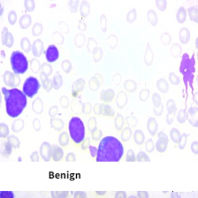
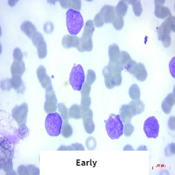
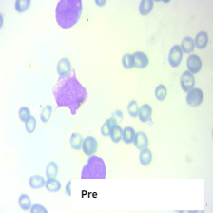
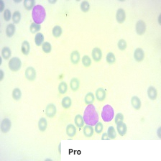
Introduction
Acute Lymphoblastic Leukemia (ALL) is a cancer of the blood cells which is characterized by a large number of immature lymphocytes, known as blast cells (myeloblasts).
According to the statistics from the World Health Organization’s (WHO’s), the number of leukemia cases in both sexes of all age groups in 2018 was 4,37,033 and a total of 3,03,006 deaths.
The images of this dataset were prepared in the bone marrow laboratory of Hospital (Tehran, Iran). This dataset consists of 3256 images from 89 suspected of ALL patients whose blood samples were prepared and stained by skillful laboratory staff.The dataset contains 4 classes Benign, Early, Pre, Pro .
In this study , we have built a custom CNN model and well known Pretrained models to detect whether a patient is affected by ALL or not and compared the accuracy between each model result.

Slide 6
Literature Review
Authors | Title | Methodology | Dataset | Advantage of the method | Disadvantage of the method
Rohan Khandekar, Prakhya Shastry, Smruthi Jaishankar, Oliver Faust ,Niranjan SampathilaJournal: Elsevier | Automated blast cell detection for Acute Lymphoblastic Leukemia diagnosis | Devloped a model using YOLOv4 Algorithm giving an f1-score of 0.92 | ALL-DB1 dataset, C_NMC2019 dataset | The proposed approach achieved high accuracy in detecting blast cells.The method is fully automated, reducing the need for manual intervention in the diagnosis process. | The study was conducted using images from only one staining method, and the proposed approach may not be suitable for other staining methods commonly used in clinical practice.
2 . Laura Boldu, Anna Merino, Andrea Acevedo, Angel Molina, José Rodellar[2021] Journal : Elsevier Masson France | A deep learning model for the diagnosis of acute leukaemia lineage using peripheral blood cell images. | Developed a VGG16,ResNet model with 85.9% and 89.3 % accuracy respectively. | Blood samples, collected in EDTA, were automatically prepared using the slide maker-stainer SP10i | It is highly accurate and uses various transfer learning methodologyaand images are in the dataset are realtime collected from a lab. | Accuracy of the proposed model can be increased.

Slide 7
Authors | Title | Methodology | Dataset | Advantage of the method | Disadvantage of the method
3. Anilkumar K.K. , Manoj V.J. , Sagi T.M. | Automated Detection of B Cell and T Cell Acute Lymphoblastic Leukaemia Using Deep Learning | The paper employs Deep Learning (CNNs) to classify Acute Lymphoblastic Leukemia subtypes without image segmentation and feature extraction, achieving a 94.12% accuracy. | Blood smear images were obtained from the American Society of Hematology | High accuracy, simplified process, and potential clinical utility. | Limited dataset, specific to B-cell and T-cell subtypes, and requires clinical validation.
4.Nathan Radakovich, Matthew Cortese, Aziz Nazha | Acute myeloid leukemia and artificial intelligence, algorithms, and new scores | Review of machine learning applications in AML using multi-omic data. | Specific datasets are mentioned in the paper, such as transcriptomic data from 105 studies, genomic data from 3241 AML patients, and data from 1540 AML patients. | Machine learning enhances AML diagnosis and prognosis, leading to personalized treatment. | Requires extensive data, potential overfitting, and the need for clinician-friendly models.

Slide 8
Authors | Title | Methodology | Dataset | Advantage of the method | Disadvantage of the method
5. Shamama Anwar, Afrin Alam Journal: Springer | A convolutional neural network–based learning approach to acute lymphoblastic leukaemia detection with automated feature extraction[2020] | Custom CNN model with 95.45 % acurracy | The Acute Lymphoblastic Leukaemia Image Database (ALL IDB) for Image Processing and has been obtained through permission from the Department of Information Technology - Universita degli Studi di Milano, Italy. | Avoid Over-training problem by using data augmentation technique. The method does not need any pre-processing or segmentation technique and works efficiently on raw data. | The study did not provide sufficient information on how the convolutional neural network was making its predictions. It require more hardware resoursces
6. Reena M. Roy, Ameer P.M. | Localization and recognition of leukocytes in peripheral blood: A deep learning approach | Semantic segmentation to precisely locate white blood cells in blood smear images. Classification: Classifying the segmented WBCs into five categories using transfer learning with AlexNet. | The paper uses an unspecified microscopic blood image dataset with 257 cells from five types of leukocytes. | High precision in WBC localization and classification accuracy. Automation reduces the reliance on manual methods. Transfer learning leverages knowledge from a large dataset for improved classification. | Lack of dataset details, raising concerns about data quality. Computational complexity not discussed. Performance may depend on data quality and hyperparameters.

Slide 9
Authors | Title | Methodology | Dataset | Advantage of the method | Disadvantage of the method
7. Siraj Khan, Muhammad Sajjad, Tanveer Hussain, Amin Ullah, Ali Shariq Imran Journal: IEEE | A Review on TML and DL Models for WBC Classification in Blood Smear Images | The paper systematically reviews TML and DL techniques for white blood cell classification in blood smear images through manual and automatic searches following PRISMA guidelines. | The Acute Lymphoblastic Leukaemia Image Database (ALL IDB) for Image Processing and has been obtained through permission from the Department of Information Technology - Universita degli Studi di Milano, Italy. | The methods enhance prediction accuracy, support medical experts in diagnosis, and contribute to hematological disorder detection, offering a comprehensive survey and identifying future research directions. | The paper doesn't explicitly mention method-related disadvantages but implies challenges in dataset availability and technique selection.
8. Pradeep Kumar Das, Sukadev Meher | An Efficient Deep CNN-based Leukemia Detection and Classification | Hybridizes MobileNetV2 and ResNet18, utilizes transfer learning for efficient leukemia detection without cell segmentation. | ALLIDB1 and ALLIDB2 are benchmark datasets for validation. | High accuracy, avoids cell segmentation, computationally efficient through hybridization, faster testing. | Lack of dataset details, raising concerns about data quality. Computational complexity not discussed. Performance may depend on data quality and hyperparameters.

Slide 10
Proposed solution with block diagram
Here we take the help of Convolutional Neural Network(CNN) to detect the stages of Acute Lymphoblastic Leukemia(ALL).
Main layers of CNN : Convolutional Layer, Pooling Layer, Fully Connected Layer.
Our CNN model has 5 Convolution layer,5 Max pool layer, 1 flatten layer, 2 dense layer and one dropout regularization layer.
Here we uses softmax activation function in output layer hence it is a multiclassification problem.
Here we trained this model by the Acute Lymphoblastic Leukemia(ALL) Dataset with 3256 images of 4 classes.
Then each image is subjected to Cleaning the noises then is passed to various layes of CNN
Convolutional Layer: Convolutional layers apply filters to input data to extract features like edges and textures. They enable the network to learn spatial hierarchies of features. The depth of the layer corresponds to the number of filters, each capturing different aspects of the data.
Pooling Layer: Pooling layers reduce the spatial dimensions of feature maps while preserving important information.
Fully Connected Layer: Fully connected layers connect every neuron from the previous layer to every neuron in the current layer. They are typically used at the end of a CNN for high-level reasoning and classification. The final fully connected layer often produces the network's output, such as class probabilities in image classification.

Slide 11
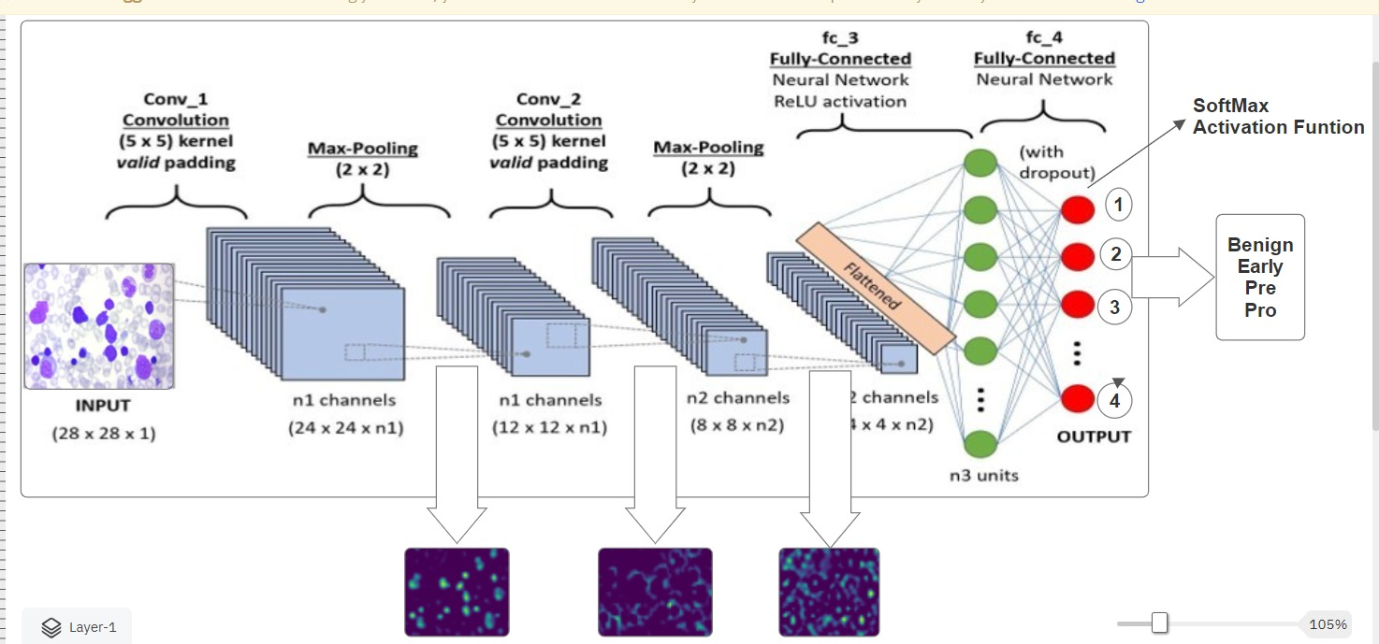
Architecture of Proposed CNN Model

Slide 12
Working Principle
1. Data Collection:
Gather a dataset of medical images that includes both positive cases (patients with ALL) and negative cases (patients without ALL).
2. Data Preprocessing:
Preprocess the images to ensure they are of uniform size and format.
3. Data Splitting:
Split the dataset into two parts: a training set and a test set.
4. Model Architecture Design:
Design the architecture of your CNN model. CNNs consist of multiple convolutional layers, pooling layers, and fully connected layers.
5. Model Compilation:
Compile the CNN model by specifying the loss function, optimization algorithm, and evaluation metrics.
6. Model Training:
Train the CNN model using the training dataset.
7. Hyperparameter Tuning:
Fine-tune hyperparameters like learning rate, batch size, and the number of layers/neurons to optimize model performance.
8. Model Evaluation:
Evaluate the trained model on the test dataset to assess its performance. Common evaluation metrics include accuracy, precision, recall, F1-score, and ROC.

Slide 13
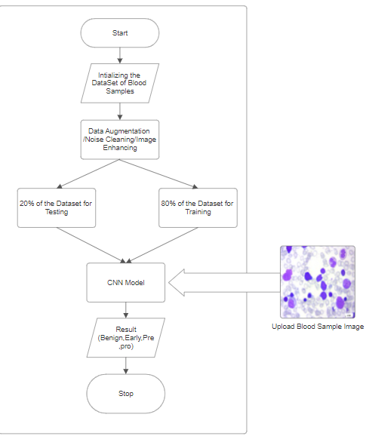
FlowChart of our Model

Slide 14
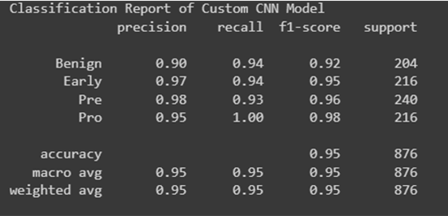
Result and Discussion:
In this proposed work when the dataset is given to the model after splitting into training and testing data we get the accuracy of the model after applying them 10 epochs.
Here we have also used data augmentation and image pre-processing before handing over the data to the model.
Overall, the study suggests that the CNN and Pretrained models can be an effective tool for Leukemia Detection, especially when combined with other pretrained models like GoogleNet, AlexNet, LeukNet etc.
The study considers evaluation parameters such as precision , recall, f1-score, accuracy. Accuracy at each epoch while training and testing is plotted on a ROC curve.

Slide 15
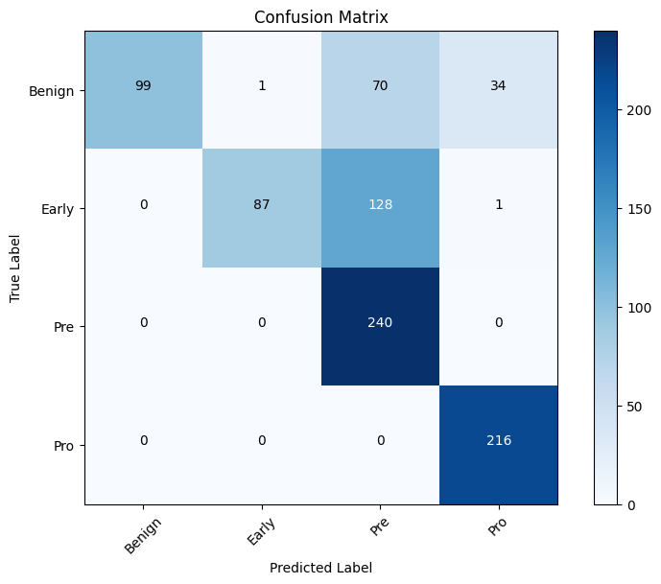
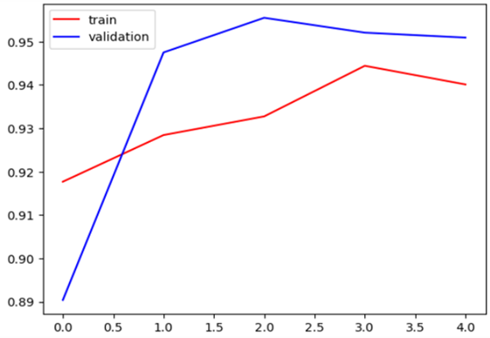
Result and Discussion:

Slide 16
Future Work
Train and test the dataset over pretrained models such as VGG-16 , GoogleNet, AlexNet.
Compare the results of each model and identify the best suited model.
Train the model on segemented images and compare the evaluation parameters obtained.
Implement ensemble methodology to determine the model which fits the best for the purpose.

Slide 17
Reference
Khandekar, Rohan, et al. "Automated blast cell detection for Acute Lymphoblastic Leukemia diagnosis." Biomedical Signal Processing and Control 68 (2021).(https://doi.org/10.1016/j.bspc.2021.102690)
Anilkumar, K. K., V. J. Manoj, and T. M. Sagi. "Automated detection of b cell and t cell acute lymphoblastic leukaemia using deep learning." (https://doi.org/10.1016/j.irbm.2021.05.005)
Das, Pradeep Kumar, and Sukadev Meher. "An efficient deep convolutional neural network based detection and classification of acute lymphoblastic leukemia." (https://doi.org/10.1016/j.eswa.2021.115311)
Anwar, Shamama, and Afrin Alam. "A convolutional neural network–based learning approach to acute lymphoblastic leukaemia detection with automated feature extraction."
(https://doi.org/10.1007/s11517-020-02282-x)
Raina, Rohini, Naveen Kumar Gondhi, Chaahat, Dilbag Singh, Manjit Kaur, and Heung-No Lee. "A Systematic Review on Acute Leukemia Detection Using Deep Learning Techniques." Archives of Computational Methods in Engineering. (https://doi.org/10.1007/s11831-022-09796-7)

Slide 18
Thank You
Por favor, conserva esta diapositiva para atribuirnos

